Slide 1
Grant Management Webinar
Presenters
Karla Freeman
Beth Romero
Chris Epoca

Slide 2
Grant Management Webinar
Fiscal Accountability
Fiscal Reports
Time and Effort Reports

Slide 3
Monitoring

Slide 4
Monitoring
Increased accountability related to American Recovery and Reinvestment Act (ARRA) funding has prompted PCCD to review and update its procedures related to fiscal monitoring practices.
PCCD will use a combination of the below forms of subgrant monitoring:
Quarterly Random Monitoring
On-Site Monitoring
Desk Review

Slide 5
Monitoring - continued
PCCD has implemented a “Risk Classification” System for subgrantees. Based on multiple factors; subgrantees will be assigned to a risk category.
A ‘high risk’ classification will result in increased monitoring and additional PCCD assistance.

Slide 6
Monitoring - continued
Quarterly Random Monitoring
Each quarter a percentage of subgrants from each risk category will be randomly selected for monitoring.
A budget ‘category’ (i.e. personnel, travel, supplies, etc.) will be chosen to monitor.
Subgrantees being monitored are required to submit fiscal documentation supporting the expenditures reported in that quarter for the ‘category’ being monitored.
Notes:
Example: Random Monitoring for quarter ending 6/30/11. the ‘Category’ to be monitored is supplies. Subgrantees would be contacted and required to submit documentation for all supplies purchased from 4/1/11 through 6/30/11.
A cover sheet must be submitted and include a listing of supplies expenditures charged to the grant this quarter.
Accounting system documentation clearly showing the amounts charged to the grant. The accounting system documentation should match what is shown on the cover sheet and the back-up documentation.
Back-up documentation (I.e. invoices) for all supplies category expenditures charged to the grant must be submitted. The back-up documentation should match what is shown on the cover sheet and the accounting system documentation.
All documents should be attached to your Egrants fiscal report.
After review and approval of the documents submitted; the approval of your fiscal Report is your indication that the documents you provided were acceptable and reconcilable. If a reimbursement payment is due – one will be processed.

Slide 7
Monitoring - continued
On-Site Monitoring
PCCD will be completing on-site fiscal monitoring of grants across all funding streams (state and federal).
Notes:
On-Site Monitoring is a federal requirement of all ARRA funds subgranted. PCCD will be completing on-site fiscal monitoring in the future of grants across all of the state and federal funding streams.
A monitoring is not intended to replace or be the same as an audit. However, if issues are determined during the course of a monitoring visit; it could present a red flag that would require further action and possibly even in an audit being done – which could ultimately end with audit findings and disallowances of expenses.

Slide 8
Monitoring – continued
Desk Review
Desk reviews of subgrants will be conducted as an alternative to on-site monitoring.

Slide 9
Monitoring - continued
Those subgrantees selected for Random or On-Site Monitoring will be notified via email.
Email will contain instructions for the subgrantee regarding what grant will be monitored, documents that must be provided, a due date or date of visit, and the name and contact information for PCCD staff performing the monitoring.

Slide 10
Monitoring - continued
Keys to the successful outcome of a monitoring by PCCD:
Make sure that your accounting system can separately identify receipts and expenditures of subgrant funds from ALL other receipts and expenditures of your organization.
Notes:
As long as your accounting system can separately identify receipts and expenditures of subgrant funds from all other receipts and expenditures of your organization – you can be assured that grant funds are not commingled with other funds of your organization.
If your accounting system cannot do this – then you should set up a separate checking account solely for the PCCD grant funds.

Slide 11
Monitoring - continued
Set up a file for your PCCD subgrant and keep documentation supporting all grant project transactions including:
Purchase Orders
Receiving Records
Paid Invoices
Cancelled Checks
Personnel Payroll, Time & Attendance Records
Documents from a competitive bid process
Any other evidence to support grant expenditures

Slide 12
Monitoring - continued
Vendor Invoices that are received from your vendors/subcontractors involved in the subgrant project should include at a minimum the following:
Payee
Invoice Date
Invoice Number
Description of each product or service provided
Unit price of each product or service provided
Total amount for each product or service
Total Invoice amount

Slide 13
Monitoring - continued
Be sure that you comply with PCCD guidelines for grant administration:
All expenditures must take place within the project period.
All contracted services must take place within the project period.
Notes:
*you may not obligate or expend grant funds prior to the start date of the project.
*You may not expend grant funds after the end date of the project UNLESS the item/service you are paying for was properly obligated prior to the end date of the project. Properly obligated means you have a contract in place, or a purchase order in hand. You may then pay for those obligated expenditures for 60 days after the project end date.

Slide 14
Egrants Fiscal Reports

Slide 15
Egrants Fiscal Reports
Several changes have been made to the Egrants fiscal report to help ensure accurate reporting and to support PCCD’s ongoing monitoring efforts.
A new column, “Expenses Paid this Period” has been added for subgrantees to input their quarterly expenses.
The column formerly labeled “expenditures to date” is now labeled Cumulative expenses.
The column previously labeled “unpaid obligations” has been changed to “Outstanding Subgrantee Obligations”.
A Budgetary Variance column has been added to the section that contains information by category. This column will display any positive percentage variance between the approved budget category amount and expenditures reported. A variance of more the 10% of the total project cost requires a Project Modification Request.

Slide 16
Fiscal Reports - continued
Notes:
In the past, expenditures were reported cumulatively. Subgrantees will now report periodic expenditures, i.e., on a quarterly report for period ending 6/30/11, only expenditures from 4/1/11 through 6/30/11 will be reported in the “Expenses Paid this Period” column.
The cumulative expenses column will be automatically populated with the sum of all periodic expenditures reported, including the most recent report.
The change to the Unpaid Obligations label was made to further clarify what amounts belong in that column. Outstanding subgrantee obligations represent items such as purchase orders or invoices received but not yet paid.

Slide 17
Fiscal Reports - continued
PCCD has modified the Egrants fiscal report to allow grantees to include line item expenditure detail.
Currently expenditures by category are entered as an aggregate of all expenses within each category.
The new report will require that line item expenditures within each category be reported separately.
PCCD will be phasing in line item detail reporting over time.

Slide 18
Fiscal Reports - continued
If detailed line item reporting is required, the budget categories will appear as links.
Notes:
This is to ensure that expenditures are consistent with approved budgets.

Slide 19
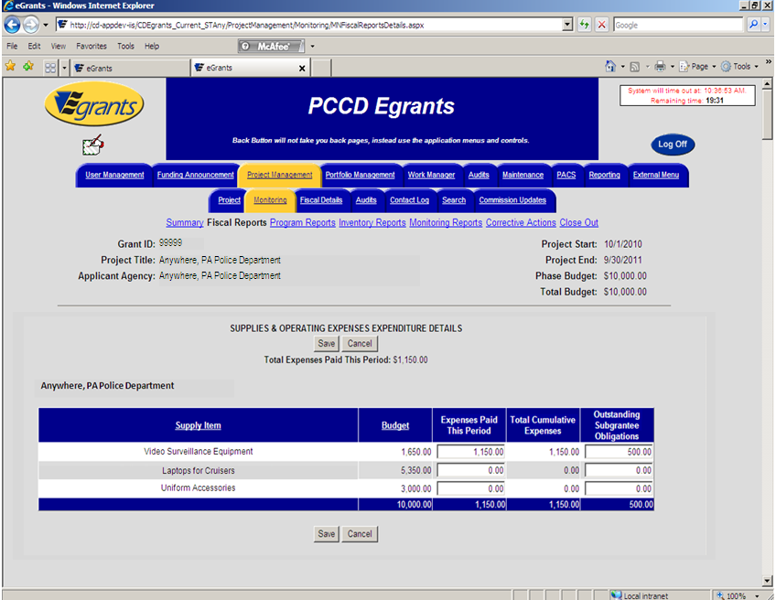
Fiscal Reports – continued
Selecting a category link will open the line item details that correspond with the approved subgrant budget.
Notes:
Outstanding Subgrantee Obligations will function the same way.

Slide 20
Fiscal Reports – continued
Periodic expenses are entered for each line item.
When all line item expenses are entered, the total by category appears on the fiscal report.

Slide 21
Fiscal Reports – continued
Attachments can now be included with Egrants fiscal reports.
If your grant is selected for random sampling as part of PCCD’s ongoing monitoring efforts, you will be asked to attach back-up documentation for the expenditures being reported in a particular category, for a specific period.
By selecting the Add Attachment button, you can browse your document files and attach them to the report.
Notes:
Details regarding the submission of back-up documentation is covered in the monitoring section of the presentation.

Slide 22
Payments
Subgrantee Payments
All subgrantees are required, at a minimum, to submit quarterly fiscal reports. PCCD will only make payments to reimburse actual expenditures reported on the fiscal reports. If an agency is experiencing cash flow problems, they may submit fiscal reports monthly and PCCD will reimburse reported expenditures.

Slide 23
Project Modification
Only items approved for funding will appear in the line item detail of the fiscal report.
To add items not previously approved, contact PCCD to discuss submitting a Project Modification Request (PMR).
Expenses incurred without prior approval may result in PCCD requesting that those funds be returned.

Slide 24
Project Modification - continued
Project Modification requests must be received no less than 30 days prior to the project end date, and are required for any of the changes listed below:
Changes between budget categories: Changes that exceed 10% of total project cost.
Changes to purchase additional items or other items that were not included in the approved project budget.
Changes to the personnel positions listed in the approved project budget including major salary reductions and increases.
A change which affects the project’s objectives or scope,
Change of project’s duration. (not all funding allows for extensions)
Notes:
Total project cost: Total project cost is the sum of the PCCD, project income and applicant's match funds.
Scope or objective change: e.g., a change in the target population and/or services to be provided. Minor changes in a project are to be reported on the Quarterly Progress Report.

Slide 25
Time and Effort Reporting

Slide 26
Time and Effort Reporting (Timesheets)
Time and effort reports (timesheets) are required for all personnel funded with PCCD grant dollars regardless of the funding stream
PCCD’s time and effort reporting standards are based on:
OMB Circular A-87 (2 CFR 225) as it relates to Governmental Units
OMB Circular A-122 (2 CFR 230) as it relates to Nonprofit Organizations
Office of Justice Programs Financial Guide

Slide 27
Time and Effort Reporting - continued
Minimum Standards for employees working on multiple activities or cost objectives:
Must be an after-the-fact determination of the employee's actual effort. Using a budget estimate instead of reporting the actual time the employee spent working on the project does not qualify as support for charges to awards.
Must account for total activity for which employees are compensated and which is required in fulfillment of their obligations to the organization.
Notes:
For example, if the employee spends 20% of their time on the PCCD grant project, 20% on a different grant project and 60% of their time on agency activities; time and effort for all three areas must be included on the report

Slide 28
Time and Effort Reporting - continued
Minimum Standards for employees working on multiple activities or cost objectives:
Must be signed by the employee and a supervisor with first-hand knowledge of the activities performed by the employee. Signature on the timesheets is affirmation that the report is an accurate accounting of the actual time the employee spent on the project.
Must be prepared at least monthly to correspond to one or more pay periods.
Volunteer time and personnel costs being used as match must be accounted for in the same manner as personnel being charged to the grant.

Slide 29
Time and Effort Reporting - continued
Minimum Standards for employees working solely on a single activity or cost objective:
Must be an after-the-fact certification that the employee worked 100 percent of their time on the grant project.
Must be prepared no less frequently than every 6 months.
Must be signed by the employee and supervisory official having first-hand knowledge of the work performed.

Slide 30
Time and Effort Reporting - continued
Minimum Standards for employees working solely on a single activity or cost objective:
Applies to full-time and part-time employee.
Employees working on ARRA projects must also maintain timesheets.

Slide 31
Time and Effort Reporting - continued
Recommended Best Practices:
Employees record time on a daily basis.
Project codes/names are provided to the employee in advance.

Slide 32
Time and Effort Reporting - continued
Sample Employee Timesheet

Slide 33
Time and Effort Reporting - continued
Sample Employee Time Certification
I certify that I worked 100% of my compensated hours on PCCD grant # ________ for the period from __________ to____________.
Employee: _________ Supervisor: ___________
Date: ______ Date: _____

Slide 34
Additional Information
PCCD’s Website – www.pccd.state.pa.us
PCCD’s Applicant’s Manual
Egrants Quick Start Guides
OJP Financial Guide – www.ojp.usdoj.gov
PCCD Grants Management Resource Account
ra-pccdgrantsmgmt@pa.gov

